Slide 1
Deviation Score
A deviation score is the difference between a raw score and the mean.
d_{i} = x_{i} - x
Where,
d_{i} is the deviation score for the ith observation in a set of observations
x_{i} is the raw score for the ith observation in a set of observations
x is the mean of all the observations in a set of observations

Slide 2
Variance
Variance is a measure of the variability or spread in a set of data. Mathematically, it is the average squared deviation from the mean score. We use the following formula to compute variance.
Var(X) = Σ ( X_{i} - X )² / N = Σ x_{i}² / N
Where,
1. N is the number of scores in a set of scores 2. X is the mean of the N scores. 3. X_{i} is the ith raw score in the set of scores 4. x_{i} is the ith deviation score in the set of scores 5. Var(X) is the variance of all the scores in the set

Slide 3
Covariance
Covariance is a measure of the extent to which corresponding elements from two sets of ordered data move in the same direction. We use the following formula to compute covariance.
Cov(X, Y) = Σ ( X_{i} - X ) ( Y_{i} - Y ) / N = Σ x_{i}y_{i} / N
Where,
1. N is the number of scores in each set of data 2. X is the mean of the N scores in the first data set 3. X_{i} is the ithe raw score in the first set of scores 4. x_{i} is the ith deviation score in the first set of scores 5. Y is the mean of the N scores in the second data set 6. Y_{i} is the ithe raw score in the second set of scores 7. y_{i} is the ith deviation score in the second set of scores 8. Cov(X, Y) is the covariance of corresponding scores in the two sets of data

Slide 4
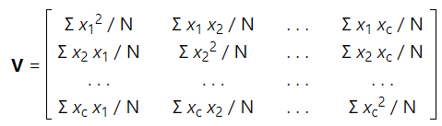
Covariance Matrix
Variance and covariance are often displayed together in a variance-covariance matrix, (aka, a covariance matrix). The variances appear along the diagonal and covariances appear in the off-diagonal elements, as shown below.
Where,
1. V is a c x c variance-covariance matrix 2. N is the number of scores in each of the c data sets 3. x_{i} is a deviation score from the ith data set 4. Σ x_{i}² / N is the variance of elements from the ith data set 5. Σ x_{i} x_{j} / N is the covariance for elements from the ith and jth data sets

Slide 5
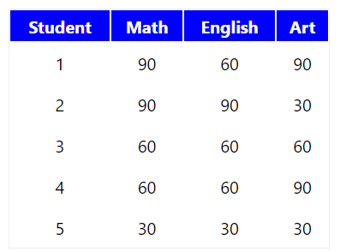
How to create a covariance matrix?
The table below displays scores on math, English, and art tests for 5 students.

Slide 6
How to create a covariance matrix?
The table below displays scores on math, English, and art tests for 5 students.
Note that data from the table can be represented in matrix A, where each column in the matrix shows scores on a test and each row shows scores for a student.

Slide 7
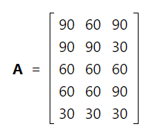
How to create a covariance matrix?
The table below displays scores on math, English, and art tests for 5 students.
Note that data from the table can be represented in matrix A, where each column in the matrix shows scores on a test and each row shows scores for a student.

Slide 8
Given the data represented in matrix A, compute the variance of each test and the covariance between the tests.

Slide 9
Given the data represented in matrix A, compute the variance of each test and the covariance between the tests.
Solution
The solution involves a three-step process.

Slide 10
Given the data represented in matrix A, compute the variance of each test and the covariance between the tests.
Solution
The solution involves a three-step process.
First, we transform the raw scores in matrix A to deviation scores in matrix a, using the transformation formula described at how to transform raw scores to deviation scores.
a = A - 1 A ( 1 / n )

Slide 11
Given the data represented in matrix A, compute the variance of each test and the covariance between the tests.
Solution
The solution involves a three-step process.
First, we transform the raw scores in matrix A to deviation scores in matrix a, using the transformation formula described at how to transform raw scores to deviation scores.
a = A - 1 A ( 1 / n )
Where,
1. 1 is an 5 x 1 column vector of ones 2. a is an 5 x 3 matrix of deviation scores: a₁₁, a₁₂, . . . , a₅₃ 3. A is an 5 x 3 matrix of raw scores: A₁₁, A₁₂, . . . , A₅₃ 4. n is the number of rows in matrix A

Slide 12
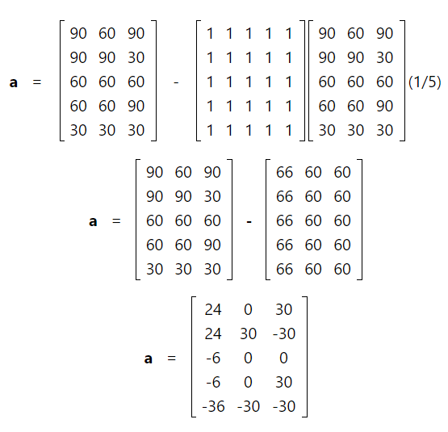
Given the data represented in matrix A, compute the variance of each test and the covariance between the tests.
Solution
The solution involves a three-step process.
First, we transform the raw scores in matrix A to deviation scores in matrix a, using the transformation formula described at how to transform raw scores to deviation scores.
a = A - 1 A ( 1 / n )
Where,
1. 1 is an 5 x 1 column vector of ones 2. a is an 5 x 3 matrix of deviation scores: a₁₁, a₁₂, . . . , a₅₃ 3. A is an 5 x 3 matrix of raw scores: A₁₁, A₁₂, . . . , A₅₃ 4. n is the number of rows in matrix A

Slide 13
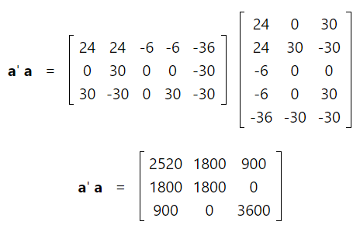
Then, to find the deviation score sums of squares matrix, we compute a'a, as shown below.

Slide 14
Then, to find the deviation score sums of squares matrix, we compute a'a, as shown below.
And finally, to create the variance-covariance matrix, we divide each element in the deviation sum of squares matrix by n, as shown below

Slide 15
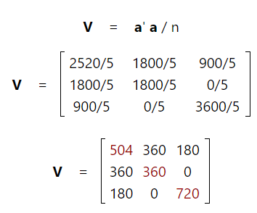
Then, to find the deviation score sums of squares matrix, we compute a'a, as shown below.
And finally, to create the variance-covariance matrix, we divide each element in the deviation sum of squares matrix by n, as shown below

Slide 16
We can interpret the variance and covariance statistics in matrix V to understand how the various test scores vary and covary.

Slide 17
We can interpret the variance and covariance statistics in matrix V to understand how the various test scores vary and covary.
Shown in red along the diagonal, we see the variance of scores for each test. The art test has the biggest variance (720); and the English test, the smallest (360). So we can say that art test scores are more variable than English test scores.

Slide 18
We can interpret the variance and covariance statistics in matrix V to understand how the various test scores vary and covary.
Shown in red along the diagonal, we see the variance of scores for each test. The art test has the biggest variance (720); and the English test, the smallest (360). So we can say that art test scores are more variable than English test scores.
The covariance is displayed in black in the off-diagonal elements of matrix V.

Slide 19
We can interpret the variance and covariance statistics in matrix V to understand how the various test scores vary and covary.
Shown in red along the diagonal, we see the variance of scores for each test. The art test has the biggest variance (720); and the English test, the smallest (360). So we can say that art test scores are more variable than English test scores.
The covariance is displayed in black in the off-diagonal elements of matrix V.
The covariance between math and English is positive (360), and the covariance between math and art is positive (180). This means the scores tend to covary in a positive way. As scores on math go up, scores on art and English also tend to go up; and vice versa.

Slide 20
We can interpret the variance and covariance statistics in matrix V to understand how the various test scores vary and covary.
Shown in red along the diagonal, we see the variance of scores for each test. The art test has the biggest variance (720); and the English test, the smallest (360). So we can say that art test scores are more variable than English test scores.
The covariance is displayed in black in the off-diagonal elements of matrix V.
The covariance between math and English is positive (360), and the covariance between math and art is positive (180). This means the scores tend to covary in a positive way. As scores on math go up, scores on art and English also tend to go up; and vice versa.
The covariance between English and art, however, is zero. This means there tends to be no predictable relationship between the movement of English and art scores.

Slide 21
We can interpret the variance and covariance statistics in matrix V to understand how the various test scores vary and covary.
Shown in red along the diagonal, we see the variance of scores for each test. The art test has the biggest variance (720); and the English test, the smallest (360). So we can say that art test scores are more variable than English test scores.
The covariance is displayed in black in the off-diagonal elements of matrix V.
The covariance between math and English is positive (360), and the covariance between math and art is positive (180). This means the scores tend to covary in a positive way. As scores on math go up, scores on art and English also tend to go up; and vice versa.
The covariance between English and art, however, is zero. This means there tends to be no predictable relationship between the movement of English and art scores.
If the covariance between any tests had been negative, it would have meant that the test scores on those tests tend to move in opposite directions. That is, students with relatively high scores on the first test would tend to have relatively low scores on the second test.

Slide 22
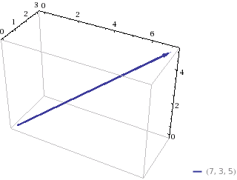
Rank of a matrix
A matrix is a collection of vectors. You can intuitively imagine a vector as a point in space. If you want, you can draw a line from the origin to that point, and put a little arrow on the tip. Normally, we imagine vectors in 2 or 3 dimensions:

Slide 23
Rank of a matrix
A matrix is a collection of vectors. You can intuitively imagine a vector as a point in space. If you want, you can draw a line from the origin to that point, and put a little arrow on the tip. Normally, we imagine vectors in 2 or 3 dimensions:
We see the vector [7, 3, 5].

Slide 24
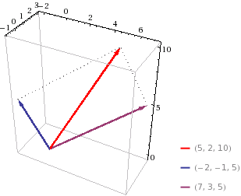
Now imagine just two of these 3D vectors. You can imagine adding these vectors by taking the tip of one, and using it as the origin of the other. That would give you some new vector.

Slide 25
Now imagine just two of these 3D vectors. You can imagine adding these vectors by taking the tip of one, and using it as the origin of the other. That would give you some new vector.
We added the original vector [7, 3, 5] (now purple) [-2, -1, 5] (blue), and got [5, 2, 10] (red).

Slide 26
Now imagine just two of these 3D vectors. You can imagine adding these vectors by taking the tip of one, and using it as the origin of the other. That would give you some new vector.
We added the original vector [7, 3, 5] (now purple) [-2, -1, 5] (blue), and got [5, 2, 10] (red).
You may notice that the new vector lies in the plane of the original two. It's no coincidence.

Slide 27
Now imagine just two of these 3D vectors. You can imagine adding these vectors by taking the tip of one, and using it as the origin of the other. That would give you some new vector.
We added the original vector [7, 3, 5] (now purple) [-2, -1, 5] (blue), and got [5, 2, 10] (red).
You may notice that the new vector lies in the plane of the original two. It's no coincidence.
If we scale the original vectors by some constant, we could shorten or increase their lengths. We could even scale them by a negative amount, and point them in the opposite direction. However, they'd still point in the same directions. When you add them, they'd still pick some new point on that same plane.

Slide 28
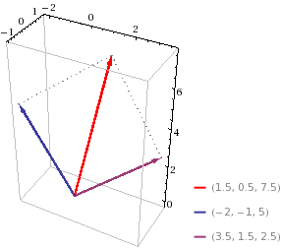
Here we scaled the original vector [7, 3, 5] by 1/2, resulting in [3.5, 1.5, 2.5]. Though the new vector after addition is a different point [1.5, 0.5, 7.5], it still lies in the same plane.

Slide 29
Here we scaled the original vector [7, 3, 5] by 1/2, resulting in [3.5, 1.5, 2.5]. Though the new vector after addition is a different point [1.5, 0.5, 7.5], it still lies in the same plane.
Now, imagine you took all possible combinations of the two vectors. The set of all possible points you could reach by scaling and adding these two vectors (including zero of each) is the entire plane that passes through the two vectors and the origin.

Slide 30
Here we scaled the original vector [7, 3, 5] by 1/2, resulting in [3.5, 1.5, 2.5]. Though the new vector after addition is a different point [1.5, 0.5, 7.5], it still lies in the same plane.
Now, imagine you took all possible combinations of the two vectors. The set of all possible points you could reach by scaling and adding these two vectors (including zero of each) is the entire plane that passes through the two vectors and the origin.
When we do this, we are imagining the space that the vectors "span". In this case, it's a plane.

Slide 31
Imagine the two vectors we started with were actually pointed in the same direction.

Slide 32
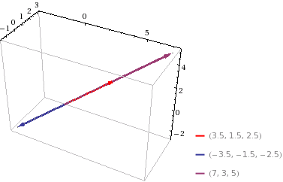
Imagine the two vectors we started with were actually pointed in the same direction.

Slide 33
Imagine the two vectors we started with were actually pointed in the same direction.
[7, 3, 5] and [-3.5, -1.5, -2.5] are two distinct vectors, but they point in the same direction. No amount of combining these two would ever escape the line they both lie on. Thus, the space "spanned" by the two vectors is a single line, rather than a plane.

Slide 34
Imagine the two vectors we started with were actually pointed in the same direction.
[7, 3, 5] and [-3.5, -1.5, -2.5] are two distinct vectors, but they point in the same direction. No amount of combining these two would ever escape the line they both lie on. Thus, the space "spanned" by the two vectors is a single line, rather than a plane.
In each case, we had two vectors, but the number of independent directions made the difference between spanning a plane vs a line. The "rank" of a matrix is the dimension of that space spanned by the vectors it contains.

Slide 35
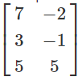
If we put the two vectors [7, 3, 5] and [-2, -1, 5] into a matrix:

Slide 36
If we put the two vectors [7, 3, 5] and [-2, -1, 5] into a matrix:
The rank of the matrix is the dimension of the space that you get by taking all combinations of the vectors. We've already done that, and saw that the space spanned by [7, 3, 5] and [-2, -1, 5] was a plane. In this case, the rank is 2 (because a plane is 2 dimensional).

Slide 37
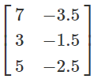
Let's put the two vectors [7, 3, 5] and [-3.5, -1.5, -2.5] into a matrix:

Slide 38
Let's put the two vectors [7, 3, 5] and [-3.5, -1.5, -2.5] into a matrix:
As we already saw, these two vectors span a line. The rank of this matrix would be the same idea: it's the dimension of the space you get by taking all combinations of the vectors. In this case, that space is just a line, so the rank is 1 (because a line is 1 dimensional).

Slide 39
Let's put the two vectors [7, 3, 5] and [-3.5, -1.5, -2.5] into a matrix:
As we already saw, these two vectors span a line. The rank of this matrix would be the same idea: it's the dimension of the space you get by taking all combinations of the vectors. In this case, that space is just a line, so the rank is 1 (because a line is 1 dimensional).
The same idea applies in higher dimensions. It just gets harder to visualize intuitively. However, even in arbitrarily high dimensions, the rank of the matrix is the dimension of the space spanned by the vectors that make up the matrix.

Slide 40
Orthonormal matrices
Orthonormal (orthogonal) matrices are matrices in which the columns vectors form an orthonormal set (each column vector has length one and is orthogonal to all the other column vectors).

Slide 41
Orthonormal matrices
Orthonormal (orthogonal) matrices are matrices in which the columns vectors form an orthonormal set (each column vector has length one and is orthogonal to all the other column vectors).
For square orthonormal matrices, the inverse is simply the transpose,
Q⁻¹ = Q^{T}

Slide 42
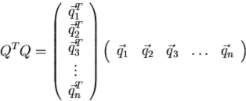
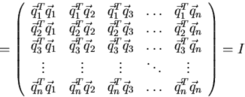
Orthonormal matrices
Orthonormal (orthogonal) matrices are matrices in which the columns vectors form an orthonormal set (each column vector has length one and is orthogonal to all the other column vectors).
For square orthonormal matrices, the inverse is simply the transpose,
Q⁻¹ = Q^{T}
This can be seen from:

Slide 43
Singular Value Decomposition (SVD)

Slide 44
The basic idea is that you can represent a matrix as a sum of other very simple matrices.

Slide 45
The basic idea is that you can represent a matrix as a sum of other very simple matrices.
It’s similar to factoring an integer into primes; the number 30 can be thought of as 2*3*5; and a matrix can be broken apart in a similar manner.

Slide 46
The basic idea is that you can represent a matrix as a sum of other very simple matrices.
It’s similar to factoring an integer into primes; the number 30 can be thought of as 2*3*5; and a matrix can be broken apart in a similar manner.
An SVD answers the question: how can I represent this matrix as a sum of as few rank-1 matrices as possible?

Slide 47
The basic idea is that you can represent a matrix as a sum of other very simple matrices.
It’s similar to factoring an integer into primes; the number 30 can be thought of as 2*3*5; and a matrix can be broken apart in a similar manner.
An SVD answers the question: how can I represent this matrix as a sum of as few rank-1 matrices as possible?
A rank-1 matrix is like pasting the same vector over and over at different scales.

Slide 48
The basic idea is that you can represent a matrix as a sum of other very simple matrices.
It’s similar to factoring an integer into primes; the number 30 can be thought of as 2*3*5; and a matrix can be broken apart in a similar manner.
An SVD answers the question: how can I represent this matrix as a sum of as few rank-1 matrices as possible?
A rank-1 matrix is like pasting the same vector over and over at different scales.
Like 1,2,3 could be a vector.

Slide 49
The basic idea is that you can represent a matrix as a sum of other very simple matrices.
It’s similar to factoring an integer into primes; the number 30 can be thought of as 2*3*5; and a matrix can be broken apart in a similar manner.
An SVD answers the question: how can I represent this matrix as a sum of as few rank-1 matrices as possible?
A rank-1 matrix is like pasting the same vector over and over at different scales.
Like 1,2,3 could be a vector.
And a rank-1 matrix from that vector could be
1,2,3
4,8,12
2,4,6
0,0,0
-1,-2,-3
all rows are scaled copies of 1,2,3.

Slide 50
This is what an SVD is - representing a matrix as a bunch of these kind of cut-and-scale-and-paste matrices.

Slide 51
This is what an SVD is - representing a matrix as a bunch of these kind of cut-and-scale-and-paste matrices.
Once you have these, you likely have a simplified representation of the original matrix. You might find your 832x9921 matrix is actually expressible as a sum of 2 rank-1 matrices; and now you’ve simplified the representation to 2 components.

Slide 52
This is what an SVD is - representing a matrix as a bunch of these kind of cut-and-scale-and-paste matrices.
Once you have these, you likely have a simplified representation of the original matrix. You might find your 832x9921 matrix is actually expressible as a sum of 2 rank-1 matrices; and now you’ve simplified the representation to 2 components.
You’ve uncovered the simple structure that underlies what may have appeared to be a complicated matrix - it might just really basically be 2 things.

Slide 53
This is what an SVD is - representing a matrix as a bunch of these kind of cut-and-scale-and-paste matrices.
Once you have these, you likely have a simplified representation of the original matrix. You might find your 832x9921 matrix is actually expressible as a sum of 2 rank-1 matrices; and now you’ve simplified the representation to 2 components.
You’ve uncovered the simple structure that underlies what may have appeared to be a complicated matrix - it might just really basically be 2 things.
SVD can uncover this structure.

Slide 54
This is what an SVD is - representing a matrix as a bunch of these kind of cut-and-scale-and-paste matrices.
Once you have these, you likely have a simplified representation of the original matrix. You might find your 832x9921 matrix is actually expressible as a sum of 2 rank-1 matrices; and now you’ve simplified the representation to 2 components.
You’ve uncovered the simple structure that underlies what may have appeared to be a complicated matrix - it might just really basically be 2 things.
SVD can uncover this structure.
Also - even if a matrix can’t be perfectly represented by a few rank-1 matrices, it might be close enough - which is usually the case with real data - and you can use this imperfect, simpler representation as a summary of a larger, more complex matrix.

Slide 55
This is what an SVD is - representing a matrix as a bunch of these kind of cut-and-scale-and-paste matrices.
Once you have these, you likely have a simplified representation of the original matrix. You might find your 832x9921 matrix is actually expressible as a sum of 2 rank-1 matrices; and now you’ve simplified the representation to 2 components.
You’ve uncovered the simple structure that underlies what may have appeared to be a complicated matrix - it might just really basically be 2 things.
SVD can uncover this structure.
Also - even if a matrix can’t be perfectly represented by a few rank-1 matrices, it might be close enough - which is usually the case with real data - and you can use this imperfect, simpler representation as a summary of a larger, more complex matrix.
This simpler representation can be easier to visualize, take up less memory, and work better in a machine learning algo.

Slide 56
I think it’s a miracle that an SVD always exists. Amazing that all matrices have that structure, regardless of what you put in them.

Slide 57
SVD formal definition
Singular value decomposition takes a rectangular matrix (defined as A, where A is a n x p matrix) and factorizes it. The SVD theorem states:
SVD(A_{nxp} ) = U_{nxn} Σ_{nxp} V^{T}_{pxp}
Where,
U^{T}U = I_{nxn}
V^{T}V = I_{pxp} (i.e. U and V are orthogonal)
Where the columns of U are the left singular vectors; Σ (the same dimensions as A) has singular values and is diagonal and V^{T} has rows that are the right singular vectors.
(singular values of a matrix A are the non-negative square roots of the eigenvalues of A^{T}A)

Slide 58
The SVD is written as X = UΣV^{T}, where U represents the m × m matrix of eigenvectors (singular vectors) for XX^{T}, V denotes the n × n matrix of eigenvectors for X^{T}X, and Σ symbolizes a m × n matrix of zeros except the singular values σ_{ii} (σ_{i}) equal to the square roots of the eigenvalues of XX^{T} and X^{T}X. Typically, the SVD is truncated such that U, Σ, and V are m × k, k × k, and n × k, respectively, where k signifies the mathematical rank of X, rank(X) = min(m,n).
The columns of U are an orthonormal basis set of vectors that span the column space of X (the range of X), that is a column in X can be written as a linear combination of the columns in U. Similarly, the columns of V are an orthonormal basis set of vectors that span the row space of X (the range of XT), that is a row in X or a column in XT can be written as a linear combination of the columns in V. The singular values are arranged from the largest to smallest and the columns in U and V are in the same relative order. Singular-value magnitudes convey the amount information or variability in respective eigenvector directions.

Slide 59
The SVD is written as X = UΣV^{T}
where,
U represents the m × m matrix of eigenvectors (singular vectors) for XX^{T}
V denotes the n × n matrix of eigenvectors for X^{T}X
Σ symbolizes a m × n matrix of zeros except the singular values σ_{ii} (σ_{i}) equal to the square roots of the eigenvalues of XX^{T} and X^{T}X.
Typically, the SVD is truncated such that U, Σ, and V are m × k, k × k, and n × k, respectively, where k signifies the mathematical rank of X, rank(X) = min(m,n).
The columns of U are an orthonormal basis set of vectors that span the column space of X (the range of X), that is a column in X can be written as a linear combination of the columns in U. Similarly, the columns of V are an orthonormal basis set of vectors that span the row space of X (the range of XT), that is a row in X or a column in XT can be written as a linear combination of the columns in V. The singular values are arranged from the largest to smallest and the columns in U and V are in the same relative order. Singular-value magnitudes convey the amount information or variability in respective eigenvector directions.

Slide 60

The SVD of a matrix provides a mechanism to compress X by reconstructing X using subsets from U, Σ, and V. For example, an assembly of X can be formed by using d columns from U and V and d columns and rows from Σ and computing where the subscript d indicates the number of eigenvectors and singular values used.

Slide 61
In a nutshell -
[U, Σ, V] = SVD(Sigma)
Interesting notes on the result of factorization:
- The columns of matrix U form the eigenvectors of Sigma. - The Σ matrix is a diagonal matrix. The values of the diagonal are called eigen values and are in descending order.

Slide 62

Why the SVD is important?
Given a matrix A, the decomposition given by the SVD

Slide 63

Why the SVD is important?
Given a matrix A, the decomposition given by the SVD
can be truncated to an approximation A^ of A given by
Where, U_{trunc} and V_{trunc} have been truncated to only have, say, k columns, and Σ_{trunc} has k columns and rows.

Slide 64
Why the SVD is important?
Given a matrix A, the decomposition given by the SVD
can be truncated to an approximation A^ of A given by
Where, U_{trunc} and V_{trunc} have been truncated to only have, say, k columns, and Σ_{trunc} has k columns and rows.
When this is done, the Frobenius norm of the error ∥A−A^∥_{F} is the smallest that it can possibly be for all the choices of U_{trunc}, Σ_{trunc}, and V_{trunc}.

Slide 65
Why the SVD is important?
Given a matrix A, the decomposition given by the SVD
can be truncated to an approximation A^ of A given by
Where, U_{trunc} and V_{trunc} have been truncated to only have, say, k columns, and Σ_{trunc} has k columns and rows.
When this is done, the Frobenius norm of the error ∥A−A^∥_{F} is the smallest that it can possibly be for all the choices of U_{trunc}, Σ_{trunc}, and V_{trunc}.
Now the key point: the smaller k is, the fewer the number of parameters needed in U_{trunc}, Σ_{trunc}, and V_{trunc}, and the smaller the number of parameters to approximate A. The fewer the number of parameters in a model, the better the generalization, given the same performance metric. Broadly (over) stating, the SVD is an algorithm for giving the best possible least-squares approximation to a matrix with rank k. The approximation from truncating the SVD is the best possible approximation from the point of view of the Frobenius norm for generalization.

Slide 66
PCA Algorithm
Before applying PCA must do data preprocessing
Given a set of m unlabeled examples we must do
Mean normalization
Replace each x_{j}^{i} with x_{j} - μ_{j},
In other words, determine the mean of each feature set, and then for each feature subtract the mean from the value, so we re-scale the mean to be 0
Feature scaling (depending on data)
If features have very different scales then scale so they all have a comparable range of values
e.g. x_{j}^{i} is set to (x_{j} - μ_{j}) / s_{j}
Where s_{j} is some measure of the range, so could be
Biggest - smallest
Standard deviation (more commonly)

Slide 67
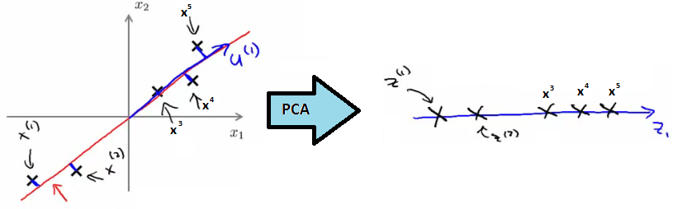
With preprocessing done, PCA finds the lower dimensional sub-space which minimizes the sum of the square
In summary, for 2D->1D we'd be doing something like this;

Slide 68
With preprocessing done, PCA finds the lower dimensional sub-space which minimizes the sum of the square
In summary, for 2D->1D we'd be doing something like this;
Need to compute two things;
Compute the u vectors
The new planes
Need to compute the z vectors
z vectors are the new, lower dimensionality feature vectors
A mathematical derivation for the u vectors is very complicated
But once you've done it, the procedure to find each u vector is not that hard

Slide 69
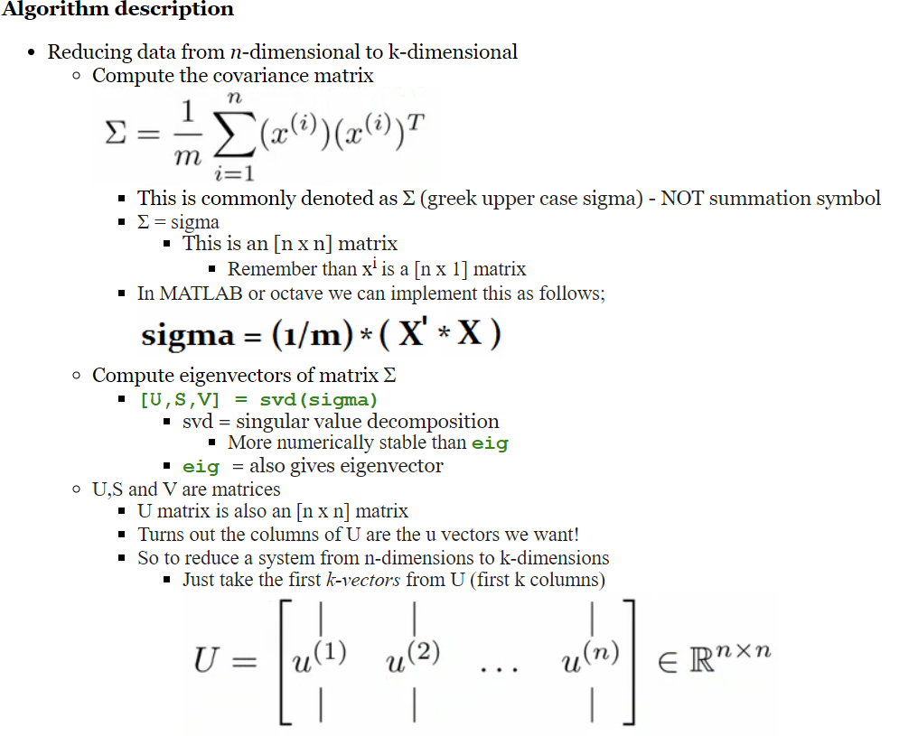

Slide 70
Next we need to find some way to change x (which is n dimensional) to z (which is k dimensional)
(reduce the dimensionality)
Take first k columns of the u matrix and stack in columns
n x k matrix - call this U_{reduce}
We calculate z as follows
z = (U_{reduce})^{T} * x
So [k x n] * [n x 1]
Generates a matrix which is
k * 1
So in summary
Preprocessing
Calculate sigma (covariance matrix)
Calculate eigenvectors with svd
Take k vectors from U (U_{reduce}= U(:,1:k);)
Calculate z (z =U_{reduce}' * x;)
No mathematical derivation
Very complicated
But it works

Slide 71
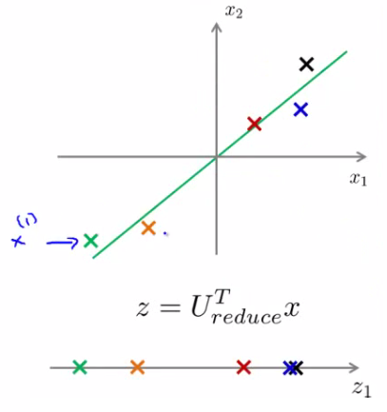
Reconstruction from Compressed Representation
We spoke about PCA as a compression algorithm
If this is the case, is there a way to decompress the data from low dimensionality back to a higher dimensionality format?
Reconstruction
Say we have an example as follows

Slide 72
We have our examples (x¹, x² etc.)
Project onto z-surface
Given a point z¹, how can we go back to the 2D space?
Considering
z (vector) = (U_{reduce})^{T} * x
To go in the opposite direction we must do
x_{approx} = U_{reduce} * z
To consider dimensions (and prove this really works)
U_{reduce} = [n x k]
z [k * 1]
So
x_{approx} = [n x 1]
So this creates the following representation

Slide 73
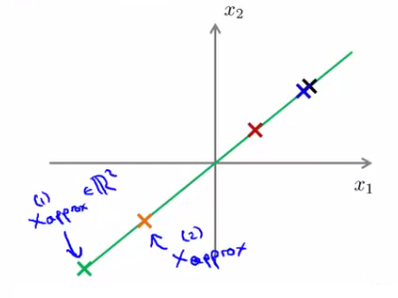
We have our examples (x¹, x² etc.)
Project onto z-surface
Given a point z¹, how can we go back to the 2D space?
Considering
z (vector) = (U_{reduce})^{T} * x
To go in the opposite direction we must do
x_{approx} = U_{reduce} * z
To consider dimensions (and prove this really works)
U_{reduce} = [n x k]
z [k * 1]
So
x_{approx} = [n x 1]
So this creates the following representation

Slide 74
EVD vs SVD
Consider the eigen decomposition A=PDP⁻¹ and SVD A=UΣV.
Some key differences are as follows,
The vectors in the eigen decomposition matrix P are not necessarily orthogonal, so the change of basis isn't a simple rotation. On the other hand, the vectors in the matrices U and V in the SVD are orthonormal, so they do represent rotations (and possibly flips).
In the SVD, the nondiagonal matrices U and V are not necessarily the inverse of one another. They are usually not related to each other at all. In the eigen decomposition the nondiagonal matrices P and P⁻¹ are inverses of each other.
In the SVD the entries in the diagonal matrix Σ are all real and nonnegative. In the eigen decomposition, the entries of D can be any complex number - negative, positive, imaginary, whatever.
The SVD always exists for any sort of rectangular or square matrix, whereas the eigen decomposition can only exists for square matrices, and even among square matrices sometimes it doesn't exist.

Slide 75


Choosing the number of Principle Components
How do we chose k ?
k = number of principle components
Guidelines about how to chose k for PCA
To chose k think about how PCA works
PCA tries to minimize averaged squared projection error
Total variation in data can be defined as the average over data saying how far are the training examples from the origin

Slide 76
